Slide 1
Analysis of Apple App Store
By Rahul Kumar

Slide 2
List of Objectives
How do the sizes of paid apps and free apps vary?
Are paid apps good Enough ?
Is extra efforts effects the rating or business ?
Exploring insights like best categories, best pricing , best size or other trending things(or efforts).
What sort of App should I create ?
Insights From Rating

Slide 3
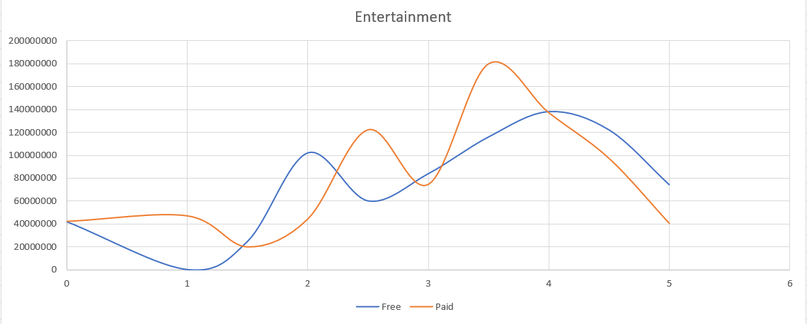
How do the sizes of paid apps and free apps vary?

Slide 4
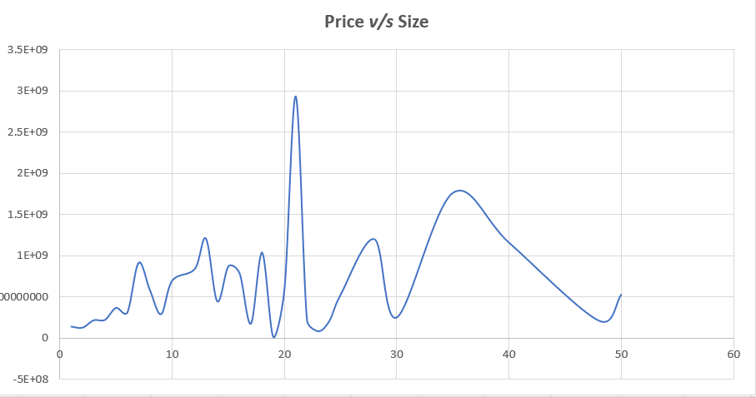
How do the sizes of paid apps and free apps vary?

Slide 5
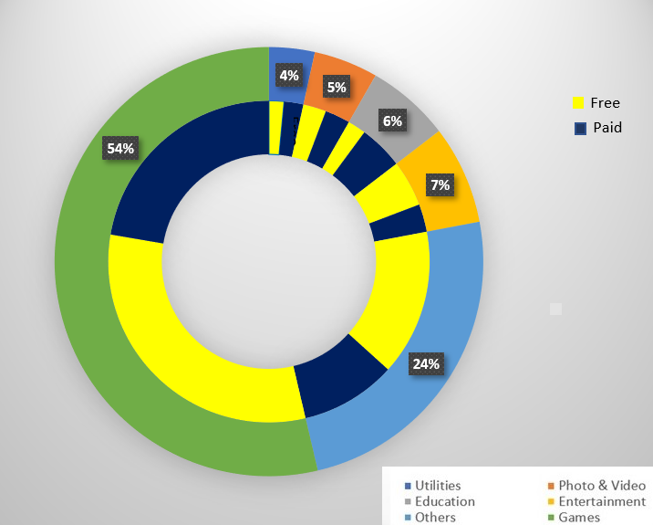
Is Paid Apps Good Enough?

Slide 6
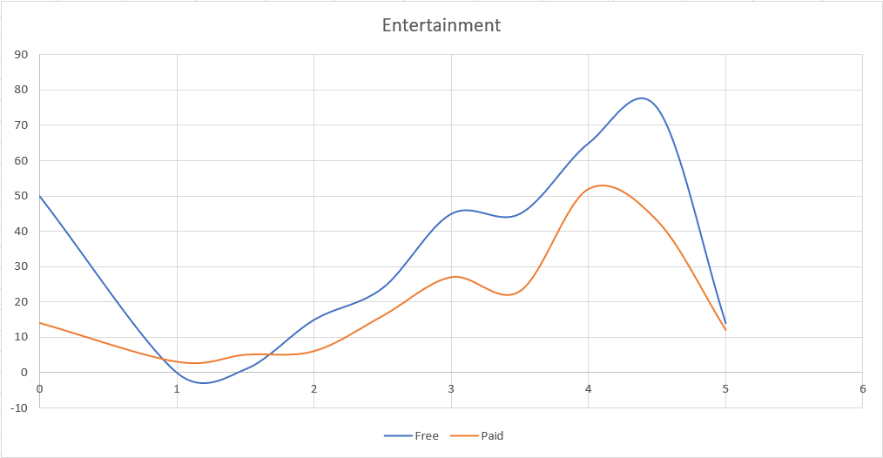
Is Paid Apps Good Enough?

Slide 7
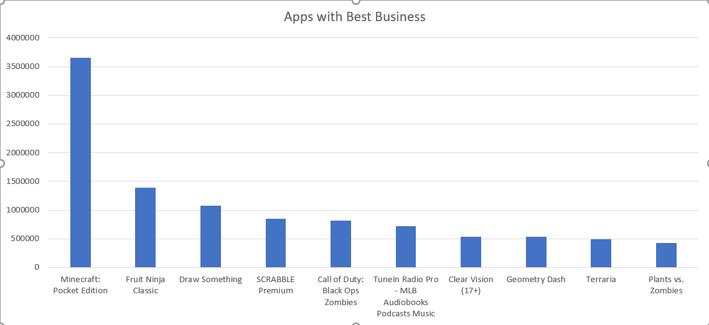
Exploring Other Useful Insights…

Slide 8
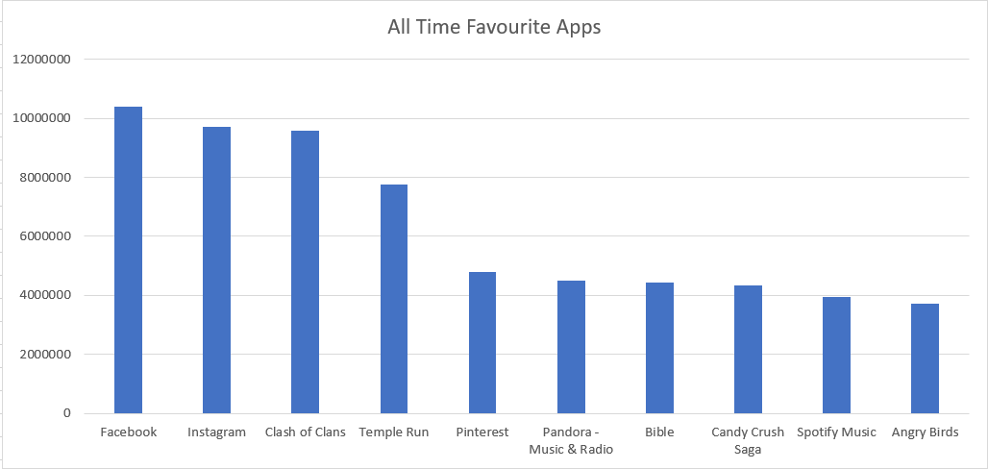
Exploring Other Useful Insights…

Slide 9
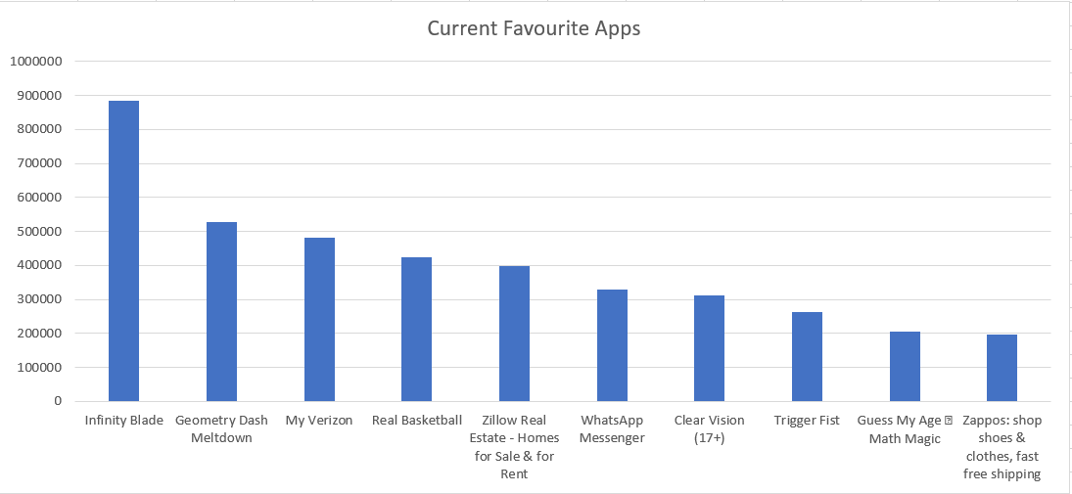
Exploring Other Useful Insights…

Slide 10
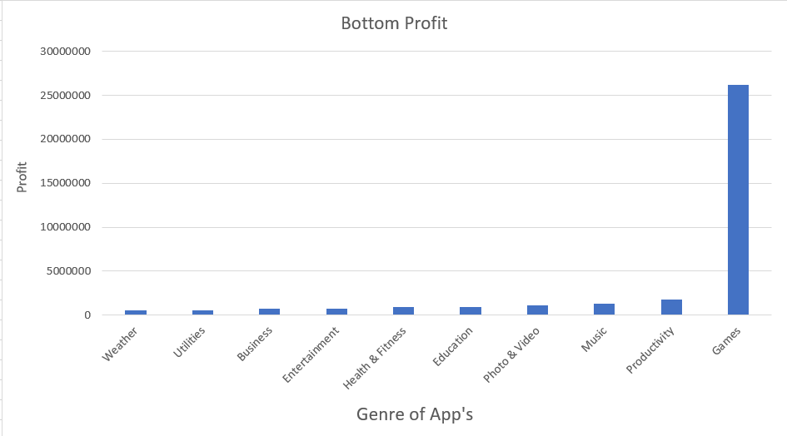
What Sort Of App Should I Develop ?

Slide 11
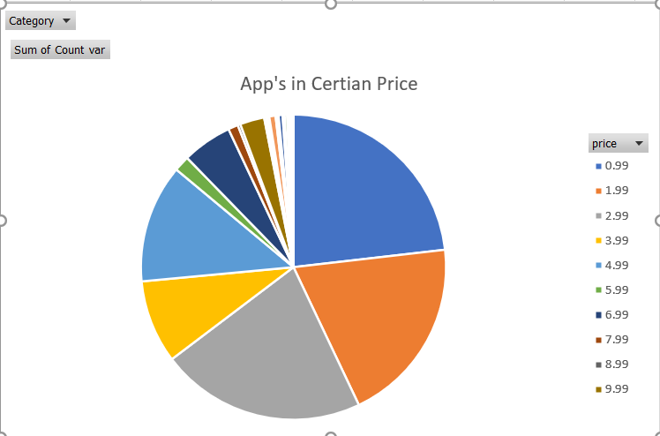
What Sort Of App Should I Develop ?

Slide 12
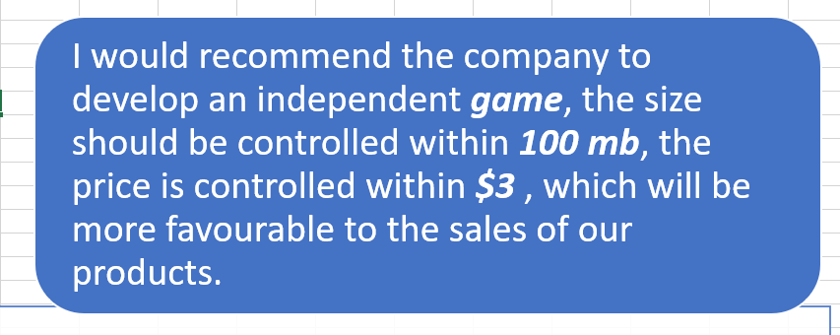
What Sort Of App Should I Develop ?

Slide 13
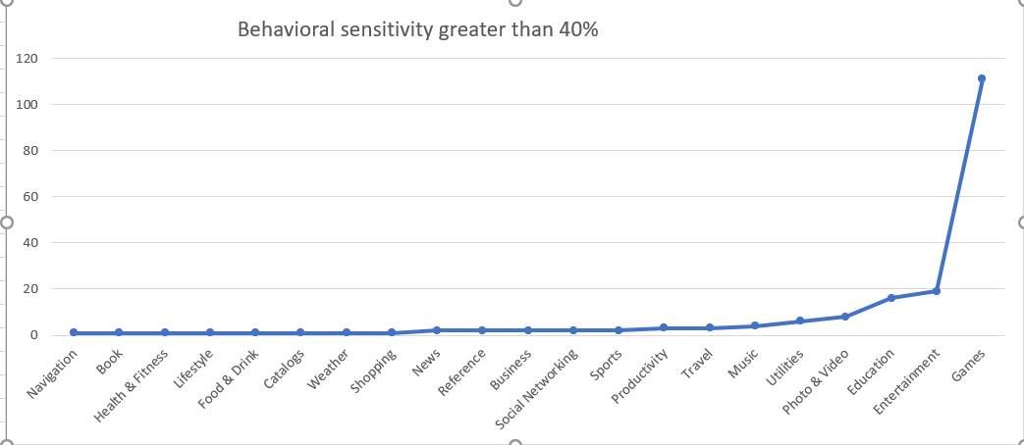
Behavioural Sensitivity

Slide 14
Thank You

